Slide 1


Slide 2
Introduction to Service Fabric
Peter Ritchie

Slide 3
Peter Ritchie
Software industry for over 26 years
Software Architect: Quicken Loans
Written three books
Visual Studio 2010 Best Practices
Refactoring with Microsoft Visual Studio 2010
Practical Visual Studio 2015 (to be released)
Microsoft MVP C#/Visual Studio
Peter.Ritchie@outlook.com
@peterRitchie

Slide 4
Why?
Internet (Elastic) Scale
Cloud
On-prem
Loosely Coupled
Depend on abstractions
Extensible
Failure tolerant
Monitorable

Slide 5
Service Fabric
Platform as a Service (PaaS) to manage scalable distributed applications
Supports microservice architecture
Deployment
ASP.NET
Web API
Services
Etc.
Azure, on-prem, or AWS

Slide 6
Reliable Services
Auto-scaling (out or in)
Name service (for behind load balancer)
Deploy
Health Monitoring
Failover
Upgrade
Rollback
Replication

Slide 7
Stateless Services
No cross-instance service state
May have “state” in database that is loaded upon each request
Receives all data it needs to perform it’s logic within each request

Slide 8
Stateful Services
In-memory state
Replicated within cluster, across nodes
Caveats
Data types must be serializable
Consider immutable or update reliable collection entry

Slide 9
Reliable Actors
Actor Model
Messages
Decoupled from communication channel
Concurrent computations

Slide 10
Reliable Collections
Replicated across service instances within cluster
Contains serializable objects
Dictionary
Queue
Managed by StateManager

Slide 11
Demo
Notes:
Explain that Service Fabric SDK needs to be installed
Note Run As Admin
Start local cluster (or check it’s started)
Create Service Fabric Application VotingApplication (4)
Create stateless web api VotingService (5)
Describe what it created Review solution explorer.
VotingApplication and VotingSerivce (6)
Implement a view/controller
VotingApplication Properties:
remove URL (12)
remove Port (13)
overwrite ValuesController with VotesController (14, 19)
Add HtmlMediaFormatter to format content files as text/html (15)
Replace Startup.cs:ConfigureApp (16)
Add index.html, make it Copy Always and explain (17, 18)
F5 (20)
Show Diagnostics Events pane in file tabs (7)
Open Service Fabric Explorer (8)
Show application (9)
Show services in application (10)
Show service instances (10)
Show nodes (1, _node_0).
Select Instance
Copy/paste URL into browser +api/index.html
Show use of UI
Stop debugging (21)
Show monitoring
Add HEALTH to build options
explain all HEALTH blocks
Show publishing locally
publish VotingApplication (28)
Attach to process VotingService
Go to front end and do some stuff and show some diagnostic events.
Break on ReportHealthAndLoad Method and wait
show health in explorer instance ESSENTIALS
Show upgrading
Add VNEXT to build
Edit Settings.XML, add Health Section and HealthCheckIntervalSeconds
Show VNEXT blocks in VotingService.cs and the VNEXT stuff
Publish (42) with Upgrade the Application
Bump version of Code to 1.0.1, click Save then Publish
Show application ESSENTIALS in SF Explorer
Show scaling (46)
Show Explorer and the one instance
Connect-ServiceFabricCluster
Update-ServiceFabricService -ServiceName fabric:/Voting/VotingService -Stateless
-InstanceCount 3 –Force
Show Explorer and the three instances.
Show upgrading with rollback
Add ROLLBACK to build (52)
show ROLLBACK block
Publish, Configure Upgrade Settings: change HealthCheckRetryTimeoutSec to 120 and HealthCheckStableDurationSec to 60 (53
Manifest Versions, change code to 1.0.3, Save (54)
Ensure Upgrade the Application
Click Publish

Slide 12
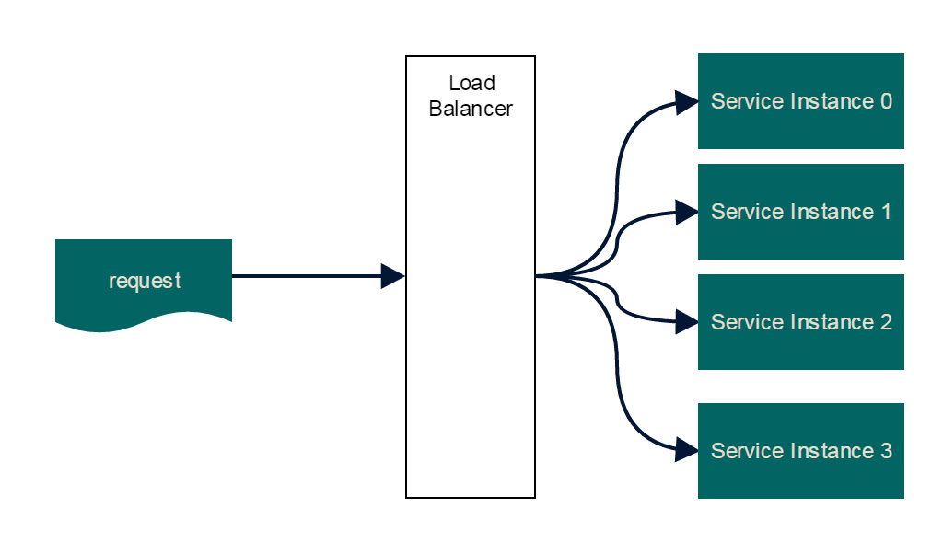
Scaling

Slide 13
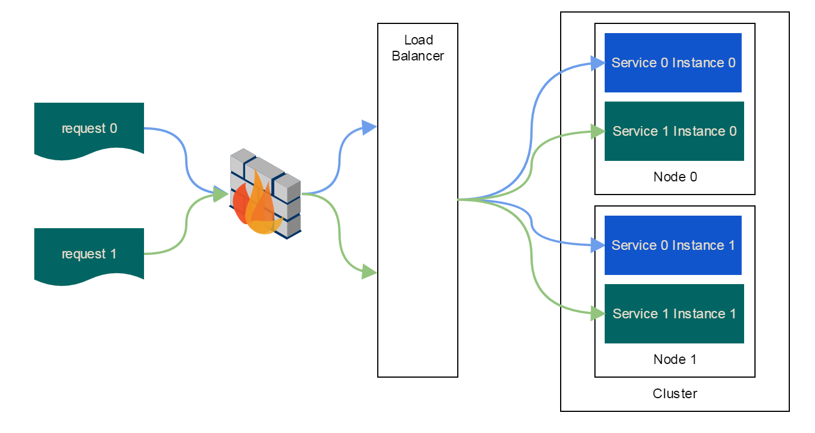
Detailed Scaling

Slide 14
Recommendations
Health, load, versioning
Loosely coupled
Overly-coupled systems are hard to auto-scale
Stay SOLID
Avoid having logic within the Service Fabric-specific code
Avoid log in contollers

Slide 15
Summary
Learned about Service Fabric
Wrote a service
The microservice approach
Example of some of the various features
Scale
Monitorable
Fault tolerant (Failure, Upgrade)

Slide 16
Q&A
Notes:
Convert a stateful webapi
Goto: http://blog.jongallant.com/2016/04/stateless-azure-service-fabric-stateful.html

Slide 17
Resources
Service Fabric book
Service Fabric site
Services
Service Oriented Architecture (SOA)
Actor Model
Service Fabric
Akka.NET

Slide 18
Thank You!
Peter.Ritche@Outlook.com
Blog.PeterRitchie.com
Source:
https://github.com/peteraritchie/introduction-to-service-fabric/releases/tag/MusicCity2017
(or http://bit.ly/mcc17-sf )

